Slide 1
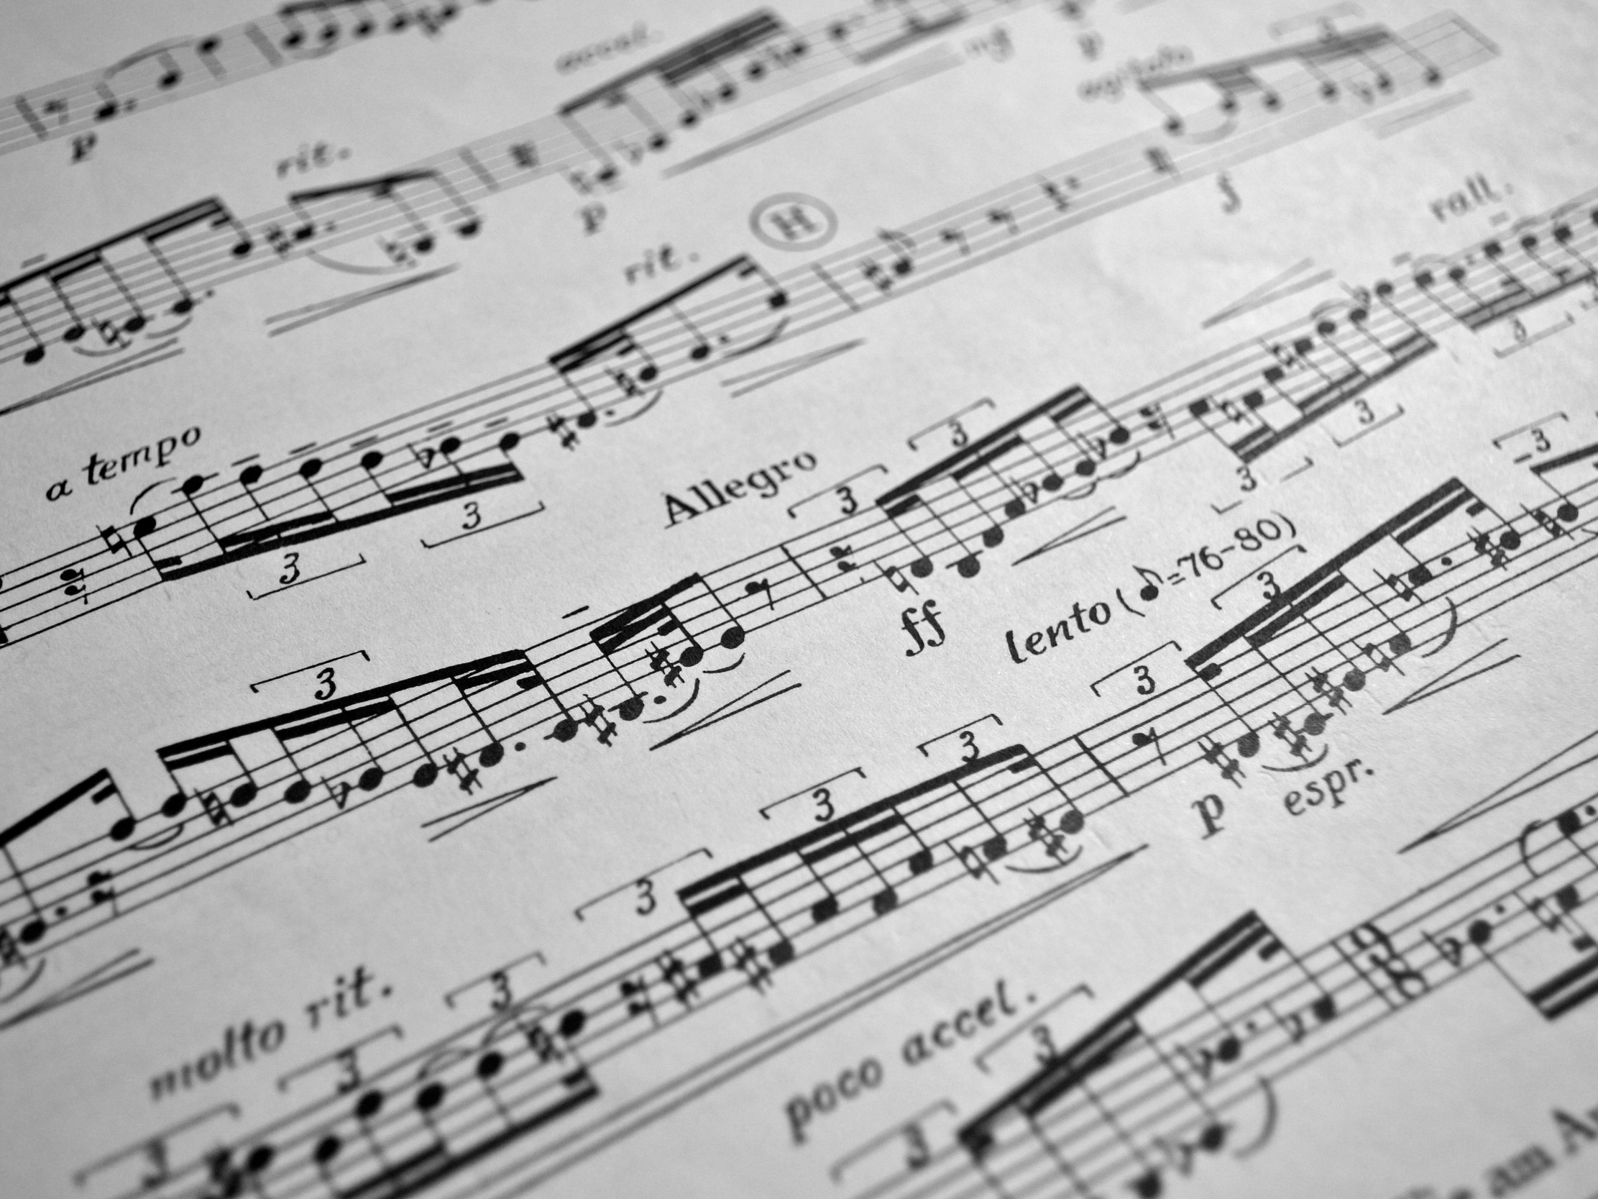

JFugue: A Musical Programming API for Java
Gillian Lemke and Nate Dubetz

Slide 2

What is JFugue?
A Java API that allows the user to create music.
Features:
Various instruments
Every key available
Length of notes
Time signatures
Rests
Chords
Use of MIDI files
Parse Music to different format types
Play music in real time

Slide 3
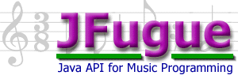
More on the API…
Originally released in 2002
Rewritten in 2015
Open-Source
Very versatile

Slide 4
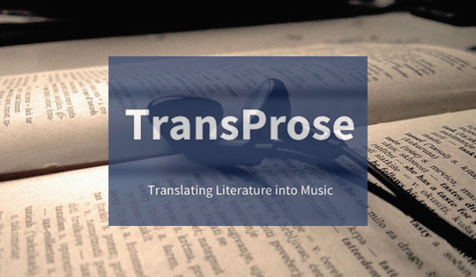
Other Programs that use JFugue
TransProse, a program that converts classic novels into music

Slide 5
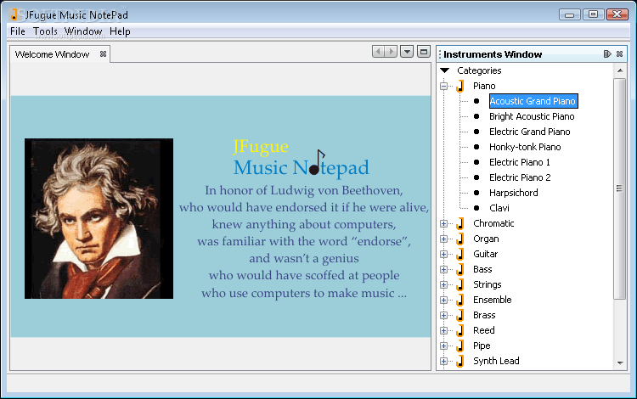
JFugue Music Notepad, GUI for JFugue

Slide 6

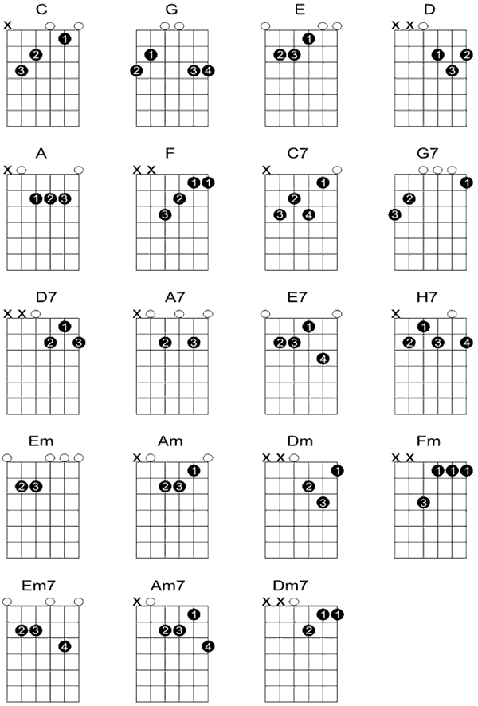

JFrets, guitar teaching tool and tab writer

Slide 7
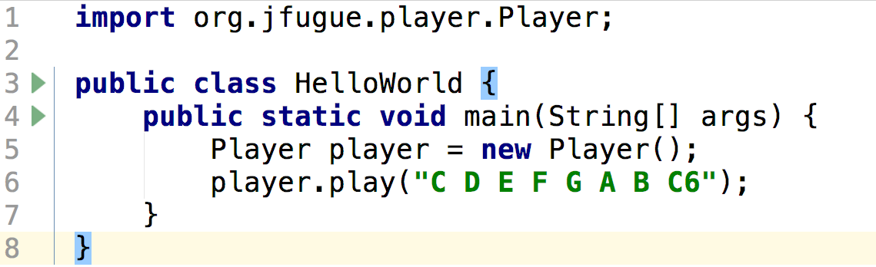
Simple program
“Hello World” in music
6 indicates octave, 6th C on the Piano
MusicString in JFugue 4, staccato in JFugue 5

Slide 8
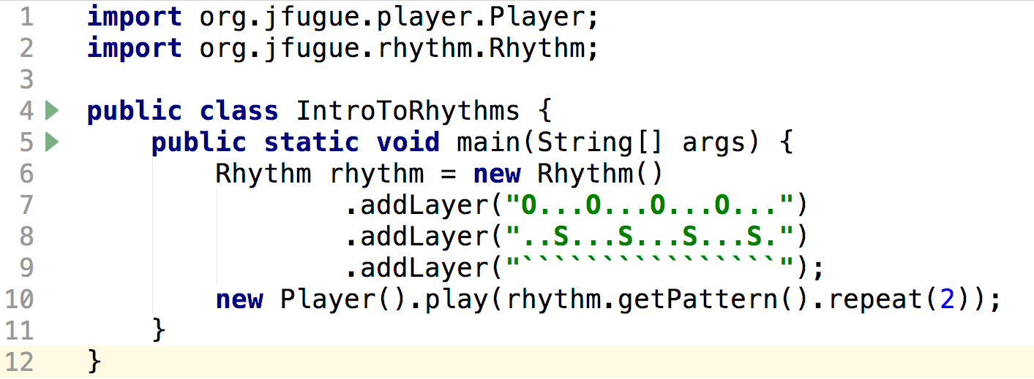
Introducing Rhythm
Indicates how many times the pattern should be repeated
Method that adds a rhythm on top of the current “song”
Gets the rhythm from the rhythm object

Slide 9
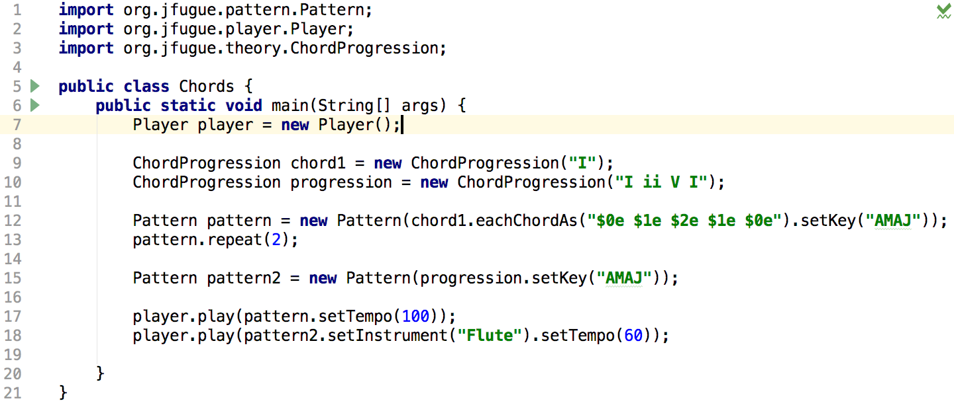
Introducing Chords and Patterns
Pattern allows rhythms, notes, or chords to be added together using .add( );
0, 1, 2 indicates the index of the note in the chord, e is the length of the note
ChordProgression is a set of chords

Slide 10
Introducing Chords and Patterns
Change instrument, default is piano
Sets the tempo to any integer in beats per minute
Changes the key to A Major

Slide 11
Uses and Future Projects
Often used to play a song or jingle upon entering a web page or program
Future Project:
Use experience in music theory to randomly generate chords based on what is theoretically correct
Sources: www.jfugue.org

